Slide 1

A Structural Pattern
prepared by Halil ZEYBEK

Slide 2

When an abstraction can have one of several possible implementations, the usual way to accommodate them is to use inheritance.
Inheritance binds an implementation to the abstraction permanently, which makes it difficult to modify, extend and reuse abstractions and implementations independently.

Slide 3

Mixing concepts with implementations can lead to hierarchies that are confusing and
difficult to maintain.
It could lead to an exponential number of subclasses and soon we will have an
exploding class hierarchy.

Slide 4

To decouple an abstraction from its implementation so that two can vary independently.

Slide 5

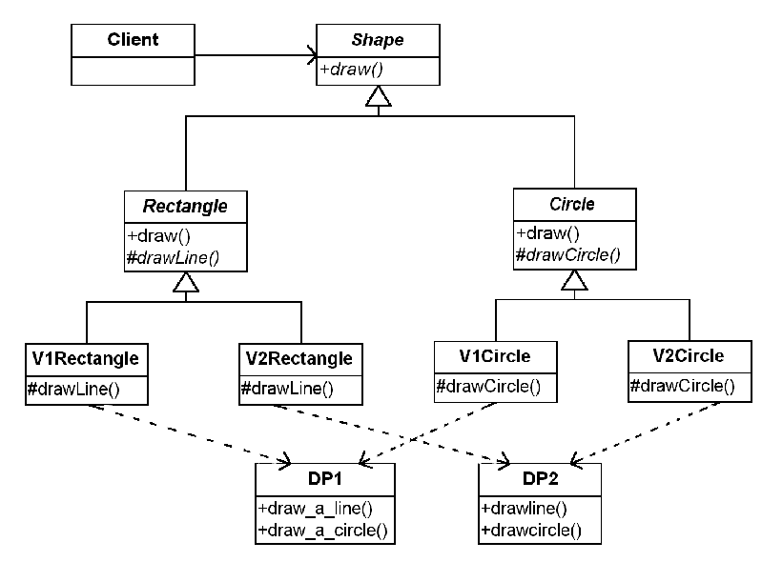

Slide 6

What happens if we get another drawing program?
➔we will have 6 different kinds of shapes!
(2 Shape concept *3 drawing programs)
What happens if we get another type of shape?
➔we will have 9 different types of shapes!
(3 shape concept * 3 drawing programs)

Slide 7

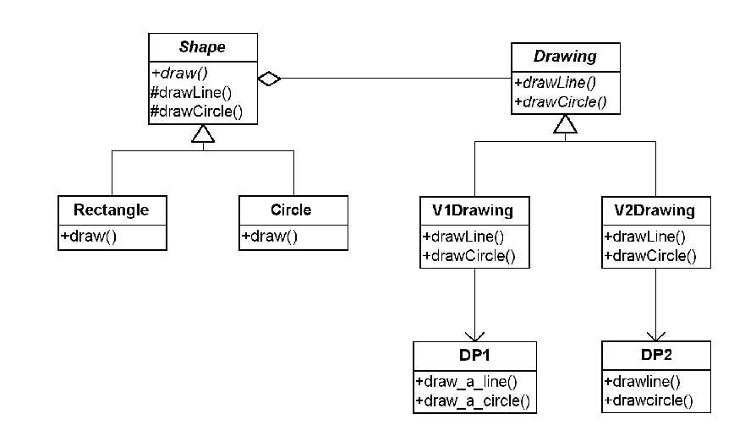

Slide 8

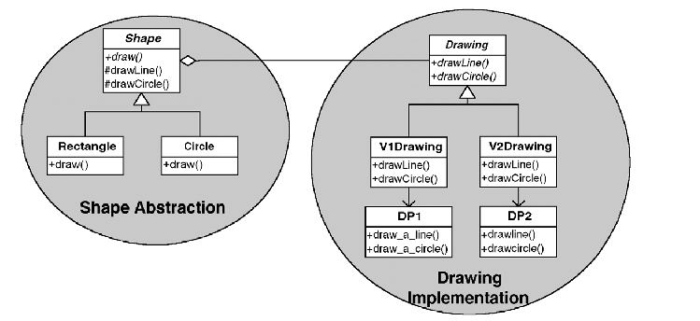

Slide 9

When you want to separate the abstract structure and its concrete implementation.
When you want to share an implementation among multiple objects
When you want to reuse existing resources in an easy to extend fashion.
When you want to hide an implementation details from clients. Changes in implementation should have no impact on clients

Slide 10

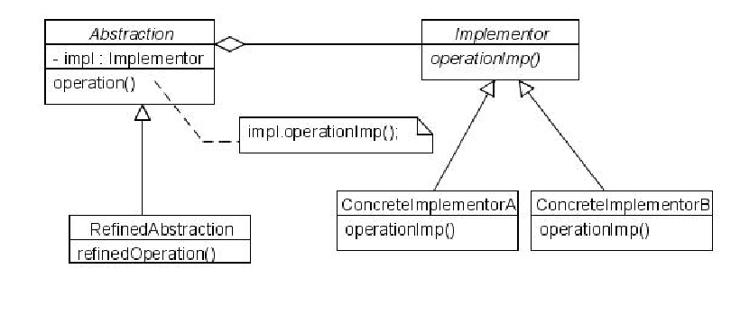

Slide 11

Abstraction defines the abstract interface and maintains the Implementor reference.
Refined Abstraction extends the interface defined by Abstraction.
Implementor defines the interface for implementation classes.
Concrete Implementor implements the Implementor interface.

Slide 12

decoupling interface & implementation
  - implementation of abstraction - can be configured at run-time
  - eliminate compile time dependencies on implementation
  - encourages layering
improved extensibility
  - Abstraction & Implementer - can be extended independently
hiding implementation details from clients

Slide 13

Abstract Factory Pattern - An Abstract Factory pattern can be used create and configure a particular Bridge, for example a factory can choose the suitable concrete implementor at runtime.

Slide 14

http://en.wikipedia.org/wiki/Bridge_pattern
GoF Design Patterns with Examples using Java and UML2
The Design Patterns Java Companion
Head First Design Patterns

